Slide 1
Addressing Multi Threading
In DEFT

Slide 2
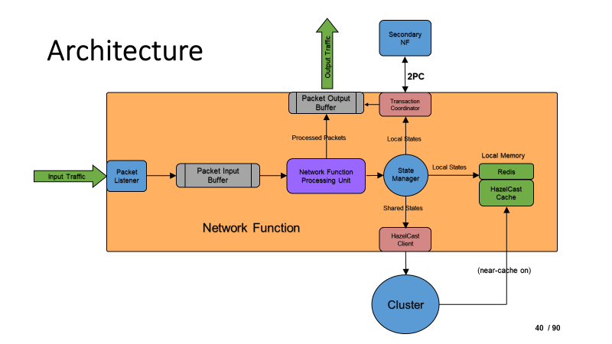

Slide 3
What to Thread?
Each Thread should consist of their own:
Packet Input Buffer: Threads must be able to hold its own packets before processing new ones
Network Function Processing Unit: This is the main process/function of the thread. Threads will enable parallel processing of packets

Slide 4


What not to Thread?
Thread 1
Thread 2
Thread 3
Each Thread should not consist their own:
Packet Output Buffer: After processing a packet, if we have different output buffers for each Thread, WE WOULD EVENTUALLY NEED TO REARRANGE THEM AGAIN IN A ANOTHER MODULE TO ACHIEVE STRONG CONSISTENCY. This is the same as a single output buffer?
NF processing unit 1
Output buffer1
Module for storing and rearranging
NF processing unit 2
Output buffer2
NF processing unit 3
Output buffer3

Slide 5
Tentative Design
Thread 1
Thread 2
Thread 3
Output traffic
Single Output Buffer
INP buffer1
NF processing unit 1
Packet Listener
INP buffer2
NF processing unit 2
State Manager
INP buffer3
NF processing unit 3
3 Separate Threads

Slide 6
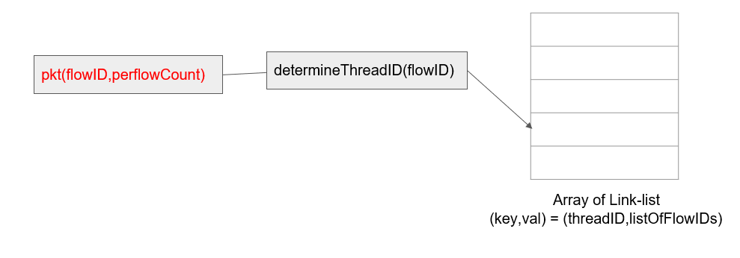
Determining which Thread
After the Stamper sets the flowID, we can determine a fixed thread for that flow and then store it in a HASHMAP so that packets of the same flow are always processed by the same Thread

Slide 7
Some more in Theory
We can use maxFlowCount, maxIdleTime variables for each Thread
Multiple flows will be processed inside a single thread
A Thread will only accept the maxFlowCount number of flows.
After being idle for a maxIdleTime time, the thread will be destroyed and that corresponding threadID will be unoccupied.
If a packet of a flow arrives in a “destroyed” thread, that thread will be restarted from idle position - This will require us to store states of the threads, even the idle ones for an indefinite time!

Slide 8
Some more in Theory
We can use maxThreads, minThreads as a global variables to determine the range of runnalble Threads.
The threadID is found using a hash function.
For a new flow, if the capacity of a thread is full, create a new Thread and assign the flow to this threadID in the HASHMAP until maxThreads number of Threads are running simultaneously.
Idle Threads should be destroyed until minThreads are running simultaneously.
If all threads’ capacity exceeds, then select the thread with: either the highest idle time or the lowest flow counts. [NEED A DECISION CRITERION]

Slide 9
Queries to be answered
How would the state manager now handle packets from different Threads?
How can Strong Consistency still be achieved?
If an Idle Thread is Destroyed, where will it’s states [for example: last processed packet number of a flow] be stored?
How would the output buffer rearrange packets from different Threads?

Slide 10
THANK YOU

